Slide 1
Parametric Study of a Multiscale Fluidic System
Using A Hybrid CFD-MD Approach
June 15th, 2010
Soon-Heum Ko¹, Nayong Kim¹, Dimitris E. Nikitopoulos^{2,3},
Dorel Moldovan^{2,3}, Shantenu Jha^{1,4}
¹ Center for Computation and Technology,
Louisiana State University
² Mechanical Engineering Dept.,
Louisiana State University
³ Center for Biomodular Multi-scale Systems,
Louisiana State University
⁴ Computer Science Dept.,
Louisiana State University

Slide 2
Research Activities
Jan. 2009
CFD-MD Research Group in CBM² for Bio-fluid Simulation
Mar. 2009
Paper Survey (Hybrid CFD-MD Approach)
Jul. 2009
CFD and MD Codes with Hybrid Interfaces
Sep. 2009
Runtime Environment for Coupled Multi-physics Apps.
Nov. 2009
Couette Flow Simulation; ECCOMAS Abstract
Feb. 2010
Unsteady Simulation (Oscillating Boundary Problem)
May 2010
Parametric Study for Real-scale Apps.
Jun. 2010
Current Status and Future Works

Slide 3
Research Activities
Jan. 2009
CFD-MD Research Group in CBM² for Bio-fluid Simulation
Mar. 2009
Paper Survey (Hybrid CFD-MD Approach)
Jul. 2009
CFD and MD Codes with Hybrid Interfaces
Sep. 2009
Runtime Environment for Coupled Multi-physics Apps.
Nov. 2009
Couette Flow Simulation; ECCOMAS Abstract
Feb. 2010
Unsteady Simulation (Oscillating Boundary Problem)
May 2010
Parametric Study for Real-scale Apps.
Jun. 2010
Current Status and Future Works

Slide 4
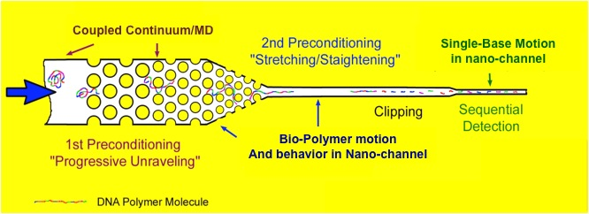
Background
CyberTools NSF-EPSCoR RⅡ project
  Computational infrastructure (CyberTools) with large-scale applications (Science driver) in supercomputing environment
    Efficient use of LONI (Louisiana Optical Network Initiative) environment
Nano-channel small molecule sensor
Hybrid Simulation

Slide 5
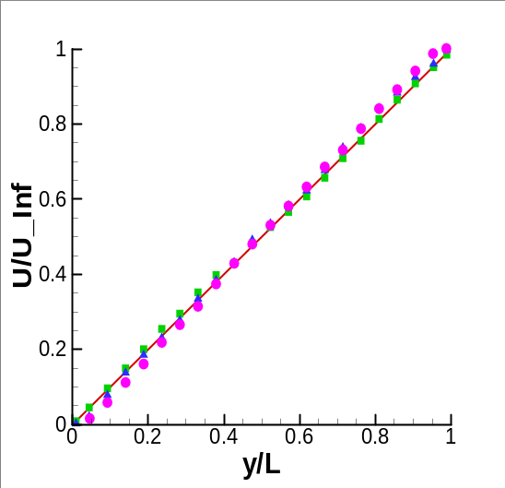
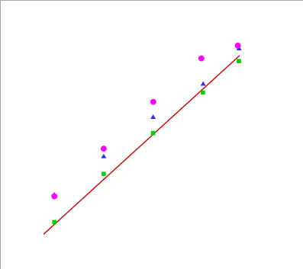
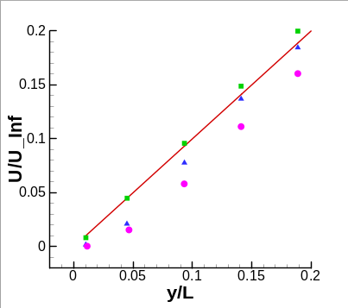
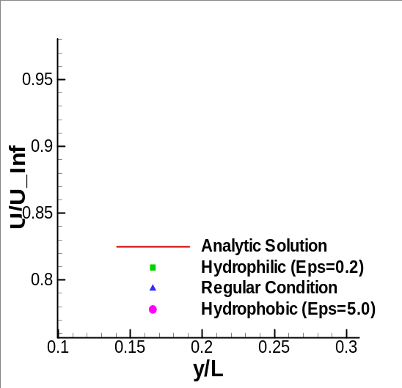
Hybrid CFD-MD Approach
CFD solves macroscopic flow characteristics while MD considers intermolecular interaction in low-speed flow region
  CFD : Increasing accuracy
    Inter-molecular effect near the wall
  MD : Reducing simulation time
    Smaller MD domain for describing the global flow feature
Notes:
In brief, hybrid CFD-MD approach is very similar to an overset grid technique. You can easily consider that we replace the subgrid in overset grid system with the molecular dynamic domain. Let me talk more details in later section.

Slide 6
Research Group
CFD codes with hybrid capability
  Soon-Heum Ko
  (Conservative Formulation)
  Dr. Nikitopoulos’s group
  (Velocity-vorticity formulation)
MD code with hybrid capability
  Dr. Nayong Kim
  (LAMMPS)
  Dr. Moldovan’s group
  (NAMD)
CFD
MD
Coupled simulation on supercomputers
  Dr. Shantenu Jha’s group
  (Development of SAGA and BigJob)
  Soon-Heum Ko, Abhinav Thota,
  Nayong Kim, Joohyun Kim
  (Use of BigJob for coupled
  runtime environment)
Computer Science

Slide 7
Research Activities
Jan. 2009
CFD-MD Research Group in CBM² for Bio-fluid Simulation
Mar. 2009
Paper Survey (Hybrid CFD-MD Approach)
Jul. 2009
CFD and MD Codes with Hybrid Interfaces
Sep. 2009
Runtime Environment for Coupled Multi-physics Apps.
Nov. 2009
Couette Flow Simulation; ECCOMAS Abstract
Feb. 2010
Unsteady Simulation (Oscillating Boundary Problem)
May 2010
Parametric Study for Real-scale Apps.
Jun. 2010
Current Status and Future Works

Slide 8
Former works
References (among multiples)
  S.T. O’Connell and P.A. Thompson (1995)
    A constrained particle dynamics with an empirical coupling parameter
  N.G. Hadjiconstantinou and A.T. Patera (1997)
    Coupling by Schwartz alternating method
  Flekkoy et al. (2000) and G. Wagner et al. (2004)
    Direct flux exchange in the hybrid interface
  X. Nie et al. (2004)
    External force to trap the particles
  R. Delgado-Buscalioni and P.V. Coveney (2004)
    Coupling strategy in time and unsteady simulation
  T.H. Yen et al. (2007)
    Hybrid simulation on large scale domains
  R. Steijl and G.N. Barakos (2009)
    Parallel computational framework and
    parametric study of coupling conditions
Notes:
What are their limits?

Slide 9
Objectives
Current status
  Computational science
    Sampling time interval and duration; extensibility and modularity of codes; co-scheduling and load balancing
  Simple problems
    Particles’ in/out through the domain interface
    Driven cavity, Couette, Poiseuille flow on Cartesian domain
  Simulation target and flow conditions
    Liquid Argon / O(100) m/s in O(10) nm scale
  Modeling
    Artificial external force, constrained MD equation
  Coupling conditions
    System size and layer size, sampling interval and duration, etc.
Goals
  Development of a hybrid simulation code
  Parametric study for determining coupling conditions
  Simulation on unsteady flowfield, fluid simulation in moderate condition

Slide 10
Research Activities
Jan. 2009
CFD-MD Research Group in CBM² for Bio-fluid Simulation
Mar. 2009
Paper Survey (Hybrid CFD-MD Approach)
Jul. 2009
CFD and MD Codes with Hybrid Interfaces
Sep. 2009
Runtime Environment for Coupled Multi-physics Apps.
Nov. 2009
Couette Flow Simulation; ECCOMAS Abstract
Feb. 2010
Unsteady Simulation (Oscillating Boundary Problem)
May 2010
Parametric Study for Real-scale Apps.
Jun. 2010
Current Status and Future Works

Slide 11
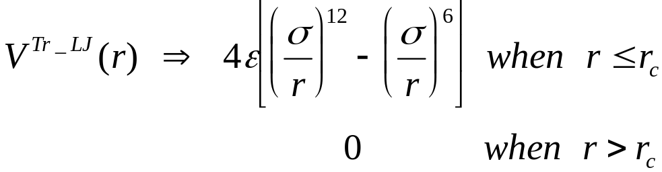
Baseline Code
CFD
  In-house code (2-D incompressible N-S, pseudo-compressibility)
    Osher's flux scheme
    LU-SGS (Lower-Upper Symmetric Gauss-Seidel)
    Incorporated with application-level checkpointing and general domain partitioning for use in runtime environment
MD
  LAMMPS (Large-scale Atomic/Molecular Massively Parallel Simulator) by Sandia Lab
    Truncated Lennard-Jones potential was used for calculating the interactions between atoms

Slide 12
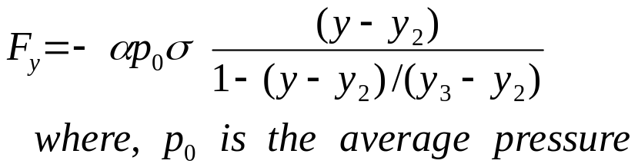
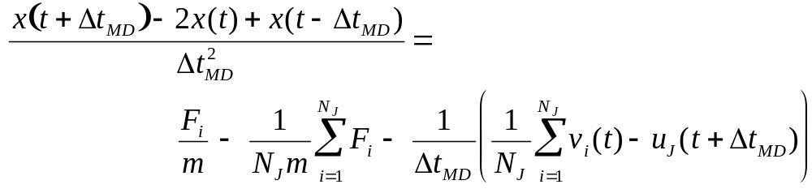
Hybrid Interfaces
CFD | MD
- Overset mesh scheme
 | - External force to trap particles inside
- Big enough not to directly interfere effects of upper and lower layers (height > cut off length)
- File interface: Sender | - File interface: Receiver - Constrained MD eqn.
Big enough not to directly interfere effects of upper and lower layers (height > cut off length)
- File interface: Receiver | - Averaging particle velocities - File interface: Sender
Notes:
Constrained MD equation lets particles in this layer shall follow the continuum velocity by average, but it also guarantees the Brownian motion of particles in this layer.

Slide 13
Research Activities
Jan. 2009
CFD-MD Research Group in CBM² for Bio-fluid Simulation
Mar. 2009
Paper Survey (Hybrid CFD-MD Approach)
Jul. 2009
CFD and MD Codes with Hybrid Interfaces
Sep. 2009
Runtime Environment for Coupled Multi-physics Apps.
Nov. 2009
Couette Flow Simulation; ECCOMAS Abstract
Feb. 2010
Unsteady Simulation (Oscillating Boundary Problem)
May 2010
Parametric Study for Real-scale Apps.
Jun. 2010
Current Status and Future Works

Slide 14
Runtime Environment for Coupled Applications
Necessities
  Co-scheduling of distinct codes
  Load balancing and more resource allocation
Runtime environment using SAGA (Simple API for Grid Application) and BigJob abstraction
  Python script submits a container job and distributes allocated processors to application codes
  Load balancing changes allocated processors to each application and restarts using its checkpointing data
S.-H. Ko, etc., “Efficient Runtime Environment for Coupled Multi-Physics Simulations: Dynamic Resource Allocation and Load-Balancing,” CCGrid 2010
 | Waiting | Inactive | Runtime
Convectional Job (32 + 32 PEs) | 83102 | 47488 | 39595
BigJob with LB (64 PEs) | 76645 | 0 | 34350
Notes:
In brief, we need to have an efficient runtime environment if we are going to run two distinct but coupled codes in the supercomputing environments and their schedulers. When we separately submit two codes, in most cases, one code will start before the other, so the first running job will wait when it needs to exchange the data with others. This is co-scheduling issue. Also, even though these two codes start at the same time, one faster job should wait for the other if two jobs have load imbalance. These two reasons make us to adopt a good runtime environment where we can control their schedules and processor distribution.

Slide 15
Research Activities
Jan. 2009
CFD-MD Research Group in CBM² for Bio-fluid Simulation
Mar. 2009
Paper Survey (Hybrid CFD-MD Approach)
Jul. 2009
CFD and MD Codes with Hybrid Interfaces
Sep. 2009
Runtime Environment for Coupled Multi-physics Apps.
Nov. 2009
Couette Flow Simulation; ECCOMAS Abstract
Feb. 2010
Unsteady Simulation (Oscillating Boundary Problem)
May 2010
Parametric Study for Real-scale Apps.
Jun. 2010
Current Status and Future Works

Slide 16
Validation
Couette flow simulation
  Liquid Argon (characteristic time scale τ=2.2*10⁻¹² sec)
  Nano-scale channel (52σ ≈176Å)
  Velocity of upper plate ≈ 155m/s

Slide 17
Research Targets
Coupling conditions
  Position and thickness of hybrid layer, MD system size,
  time scale, sampling time interval and duration
Unsteady flow simulation
  Time-accurate problems
    Coupling scheme in time
Real-scale flow simulation
  Fluid materials, velocity, system scale
    More time to converge on bigger systems
    Inherent Brownian motion and resultant noise becomes dominant on low-speed flow
    Modeling for polyatomic molecules: considering Coulomb force, improving constrained MD equation of motion
Notes:
After the validation, we were going to address these problems and described in the ECCOMAS abstract. First one is … and the second one is … . However, soon I found that they are very tough to resolve with our current implementation.

Slide 18
Research Activities
Jan. 2009
CFD-MD Research Group in CBM² for Bio-fluid Simulation
Mar. 2009
Paper Survey (Hybrid CFD-MD Approach)
Jul. 2009
CFD and MD Codes with Hybrid Interfaces
Sep. 2009
Runtime Environment for Coupled Multi-physics Apps.
Nov. 2009
Couette Flow Simulation; ECCOMAS Abstract
Feb. 2010
Unsteady Simulation (Oscillating Boundary Problem)
May 2010
Parametric Study for Real-scale Apps.
Jun. 2010
Current Status and Future Works

Slide 19
Coupling Conditions
Pure MD simulation (relaxation process)
  Impose stationary initial and boundary conditions and
  run until the flow stabilizes (called Relaxation)
  On various time scales, sampling interval, layer depth,
  system scale
    Thicker layer with longer sampling time considering the characteristics of flow physics
    Reduce ∆t_{MD}: Not so effective for reducing the noise
    Bigger system size in principal direction was more effective than increase in periodic direction
∆t=10⁻³τ, Lx=40σ, Lz=15σ
∆t=10⁻³τ, Lx=80σ, Lz=15σ
∆t=10⁻³τ, Lx=160σ, Lz=15σ
1 tau
2 tau
4 tau
8 tau
16 tau
32 tau
1 tau
1 tau
2 tau
2 tau
4 tau
4 tau
8 tau
8 tau
16 tau
16 tau
32 tau
32 tau
0.1 sigma
0.03897
0.029166
0.021557
0.016835
0.012734
0.010316
0.1 sigma
0.1 sigma
0.02837
0.023577
0.023025
0.016684
0.020259
0.012762
0.014855
0.012421
0.011986
0.009154
0.009354
0.008156
0.2 sigma
0.2 sigma
0.2 sigma
0.032589
0.023655
0.020196
0.024365
0.019668
0.013967
0.018773
0.018715
0.011196
0.015296
0.013647
0.01178
0.011334
0.011437
0.008802
0.009572
0.009122
0.007972
0.4 sigma
0.4 sigma
0.4 sigma
0.025811
0.020831
0.016701
0.022016
0.018491
0.011753
0.016864
0.017767
0.010209
0.013933
0.012648
0.011346
0.010523
0.010685
0.008688
0.008735
0.008748
0.007916
0.8 sigma
0.8 sigma
0.022049
0.015342
0.019193
0.01064
0.015516
0.009327
0.013463
0.010793
0.009422
0.00838
0.008201
0.8 sigma
0.018816
0.017906
0.017053
0.012352
0.010297
0.007766
0.008339
1.6 sigma
0.018774
0.018226
0.014143
0.011247
0.007721
0.007747
1.6 sigma
1.6 sigma
0.017959
0.01419
0.016092
0.009834
0.015762
0.009285
0.012038
0.010468
0.010207
0.008115
0.008044
0.007672
3.2 sigma
0.017376
0.017962
0.013736
0.010862
0.00662
0.006429
3.2 sigma
3.2 sigma
0.013933
0.011073
0.013684
0.008635
0.014304
0.00795
0.010389
0.009958
0.009794
0.008115
0.007885
0.007405
∆t=10⁻⁴τ, Lx=40σ, Lz=5σ
∆t=5*10⁻³τ, Lx=40σ, Lz=5σ
∆t=10⁻³τ, Lx=40σ, Lz=5σ
1 tau
2 tau
4 tau
8 tau
16 tau
32 tau
1 tau
1 tau
2 tau
2 tau
4 tau
4 tau
8 tau
8 tau
16 tau
16 tau
32 tau
32 tau
0.1 sigma
0.077729
0.062558
0.048524
0.037529
0.03156
0.023296
0.1 sigma
0.1 sigma
0.076687
0.072581
0.056015
0.055846
0.043858
0.045187
0.035726
0.030141
0.025608
0.018514
0.023979
0.01979
0.2 sigma
0.2 sigma
0.2 sigma
0.063225
0.060901
0.068395
0.049153
0.05097
0.054294
0.038751
0.039737
0.044798
0.032926
0.02667
0.034836
0.023728
0.016421
0.029806
0.023475
0.01853
0.02243
0.4 sigma
0.4 sigma
0.4 sigma
0.056695
0.051713
0.058948
0.043785
0.042517
0.050013
0.035165
0.036676
0.042595
0.031178
0.024135
0.033129
0.022305
0.014289
0.028392
0.022661
0.017431
0.021704
0.8 sigma
0.8 sigma
0.8 sigma
0.051598
0.0475
0.052668
0.040887
0.039483
0.046317
0.032876
0.034537
0.040927
0.029371
0.022598
0.031329
0.020958
0.013108
0.02829
0.021561
0.017252
0.021028
1.6 sigma
0.04457
0.040083
0.039038
0.029542
0.028054
0.020911
1.6 sigma
1.6 sigma
0.046922
0.037861
0.035828
0.034714
0.026995
0.031126
0.025629
0.019574
0.019547
0.010324
0.021277
0.015491
3.2 sigma
0.035236
0.029713
0.030352
0.026632
0.027042
0.019317
3.2 sigma
3.2 sigma
0.028007
0.034058
0.028832
0.032768
0.024196
0.029123
0.023764
0.017852
0.018181
0.009688
0.021069
0.015087

Slide 20
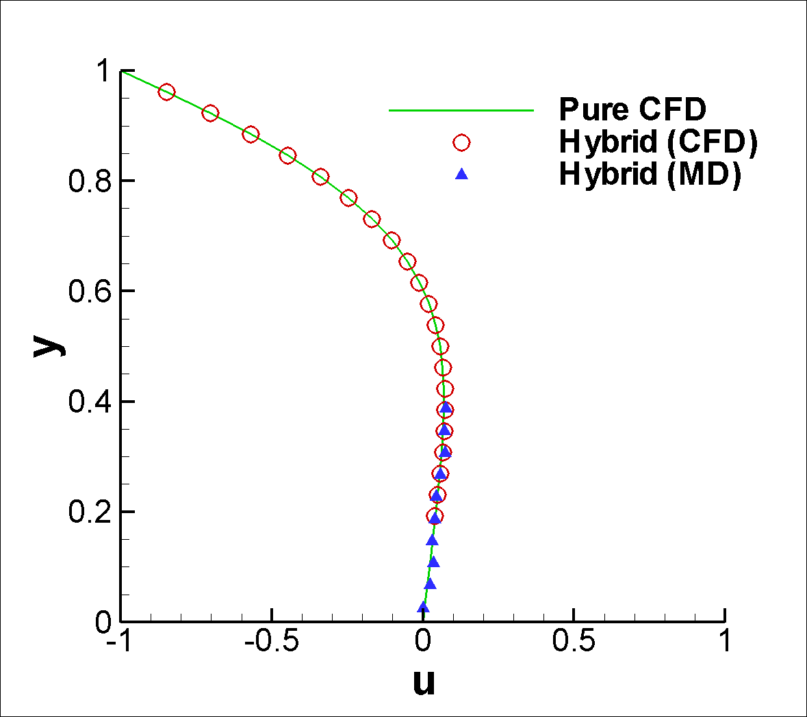
Oscillating Boundary Problem
  The same conditions as Couette flow simulation except harmonic oscillation of upper plate with T=4.4*10⁻¹⁰ seconds
    Liquid Argon, 52σ height, maximum velocity of 155m/s
    ∆t_{MD}=1*10⁻³τ, layer size of 2σ, sampling for 10τ
    X ≈ 200σ, two ghost layers in overlapping boundary

Slide 21
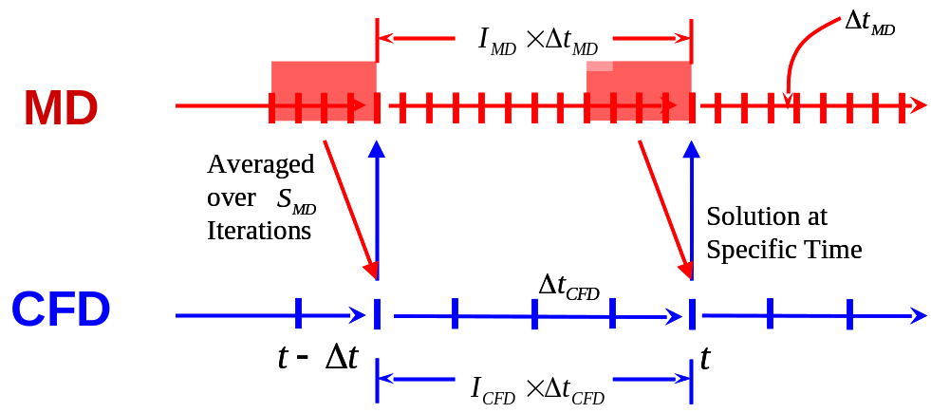
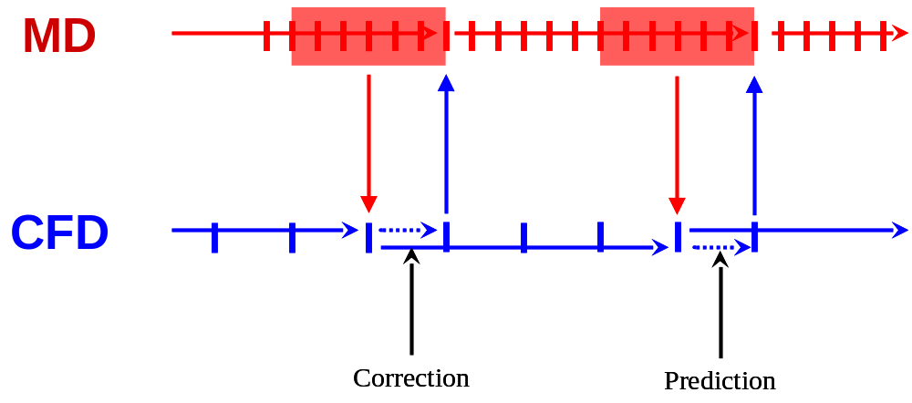
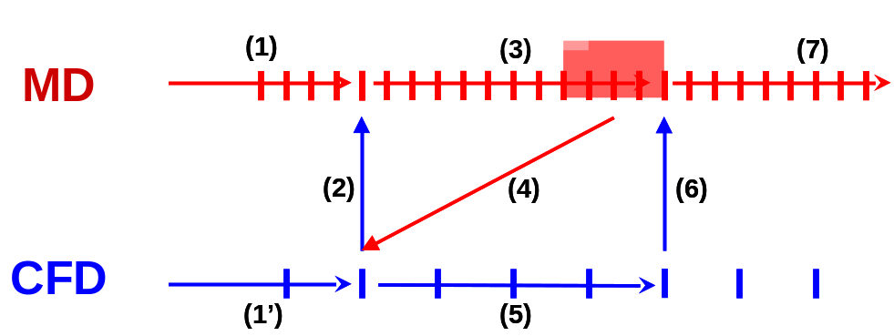
Time Coupling Strategies
Synchronized and sequential coupling
  Better parallel performance by synchronized coupling /
  time lagging in the boundary
Prediction-correction approach
  CFD advances to one time step for data exchange and re-computes from the former time step after communication

Slide 22
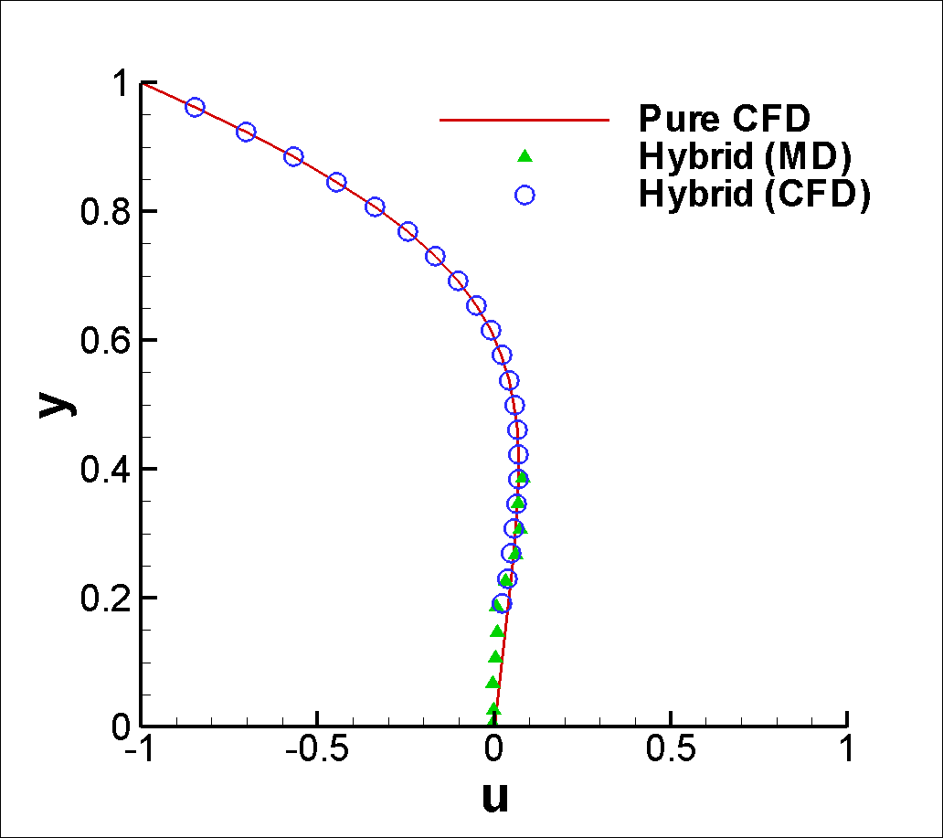
Unsteady Simulation
Oscillating Boundary Problem
  Reduces the time-lagging between CFD and MD domains in the overlapping region

Slide 23
Research Activities
Jan. 2009
CFD-MD Research Group in CBM² for Bio-fluid Simulation
Mar. 2009
Paper Survey (Hybrid CFD-MD Approach)
Jul. 2009
CFD and MD Codes with Hybrid Interfaces
Sep. 2009
Runtime Environment for Coupled Multi-physics Apps.
Nov. 2009
Couette Flow Simulation; ECCOMAS Abstract
Feb. 2010
Unsteady Simulation (Oscillating Boundary Problem)
May 2010
Parametric Study for Real-scale Apps.
Jun. 2010
Current Status and Future Works

Slide 24
Parametric Study for Real-scale Simulations
Relaxation simulation
  System size: 10 times bigger in height (520σ)
  Fluid element: Liquid argon
    Time to set up real-molecular domain (water) and improvement of constrained MD equation
∆t=10⁻³τ, Lx=40σ, Lz=5σ
∆t=10⁻³τ, Lx=200σ, Lz=5σ
10tau
10tau
20tau
20tau
40tau
40tau
80tau
80tau
160tau
160tau
320tau
320tau
640tau
640tau
1sigma
1sigma
0.009766
0.009766
0.007459
0.007459
0.006626
0.006626
0.005798
0.005798
0.004694
0.004694
0.004736
0.004736
0.003083
0.003083
2sigma
0.009166
0.006908
0.006421
0.005716
0.00462
0.004671
0.003038
2sigma
0.009166
0.006908
0.006421
0.005716
0.00462
0.004671
0.003038
4sigma
0.008217
0.006337
0.006024
0.005558
0.004402
0.004615
0.002981
4sigma
0.008217
0.006337
0.006024
0.005558
0.004402
0.004615
0.002981
8sigma
8sigma
0.006713
0.006713
0.005089
0.005089
0.005213
0.005213
0.00509
0.00509
0.004233
0.004233
0.004549
0.004549
0.002928
0.002928
16sigma
16sigma
0.004899
0.004899
0.003684
0.003684
0.003196
0.003196
0.003785
0.003785
0.003721
0.003721
0.003861
0.003861
0.002733
0.002733
32sigma
0.002313
0.002249
0.002399
0.003086
0.003127
0.003493
0.002617
32sigma
0.002313
0.002249
0.002399
0.003086
0.003127
0.003493
0.002617

Slide 25
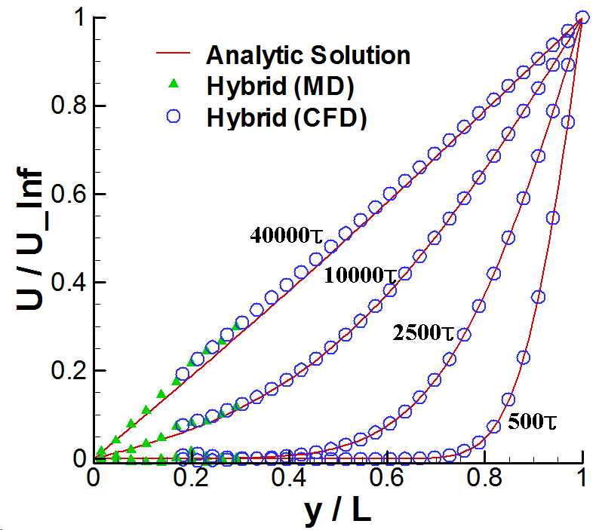
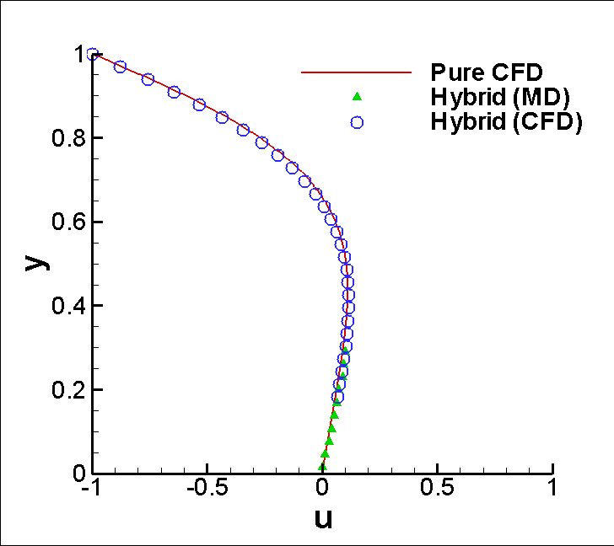
Simulations on Larger Domain
Simulation conditions
  Same ∆t_{MD} and velocity, layer size of 16σ, sampling for 100τ
  Far longer time until convergence
Couette Solution
Unsteady Oscillation

Slide 26
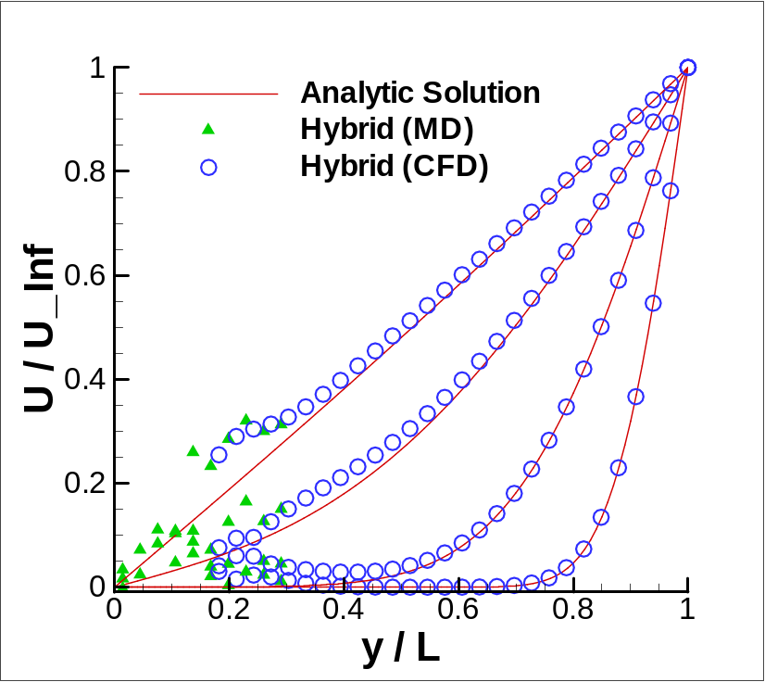
Low-speed Flow Simulation
O(10) Velocity
  Strong noise from MD solution
    Need to increase sampling duration

Slide 27
Research Activities
Jan. 2009
CFD-MD Research Group in CBM² for Bio-fluid Simulation
Mar. 2009
Paper Survey (Hybrid CFD-MD Approach)
Jul. 2009
CFD and MD Codes with Hybrid Interfaces
Sep. 2009
Runtime Environment for Coupled Multi-physics Apps.
Nov. 2009
Couette Flow Simulation; ECCOMAS Abstract
Feb. 2010
Unsteady Simulation (Oscillating Boundary Problem)
May 2010
Parametric Study for Real-scale Apps.
Jun. 2010
Current Status and Future Works

Slide 28
Conclusion
Hybrid CFD-MD Approach
  Better solution near the solid body with acceptable efficiency
Development of hybrid CFD-MD framework
  Individual codes with hybrid interface
  Runtime environment for co-scheduling and load balancing
Applications to nano-scale systems
  Coupling conditions determined from relaxation process
  Couette flow simulation and oscillating boundary problem
    Improving time-coupling strategy
  Simulation on larger domain
    Larger layer with longer sampling duration
  Low-speed flow simulation
    Requires more sampling duration

Slide 29
Current and Future Works
Simulation on low-speed flow system
  Parametric study on coupling condition
Realistic flow simulation (water filled in carbon tube)
  Improvement of a constrained MD equation
  Accurate solution on interaction between fluid and solid domains expected

